Slide 1
Text Analysis: Matching and Linking for Joining Data
Austin Alleman
November 20, 2019

Slide 2
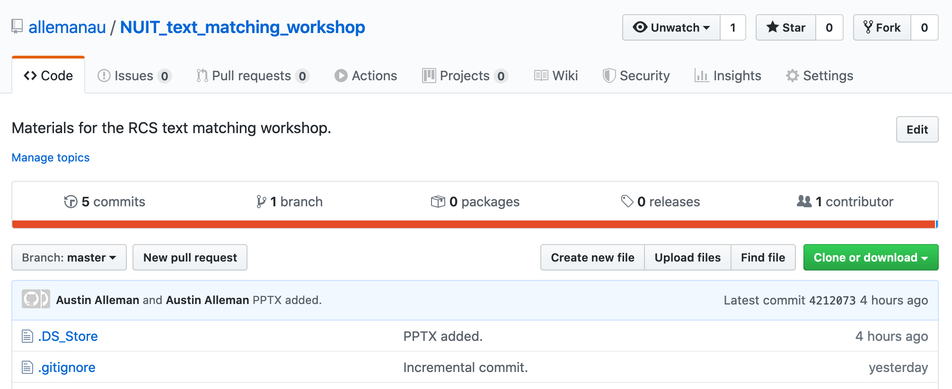
Workshop Resources
All materials, including these slides, R scripts, and an RMarkdown version of this workshop (for those who prefer) are available here:
https://github.com/allemanau/NUIT_text_matching_workshop

Slide 3
INTRODUCTIONS
Who am I?
Data science research consultant with NUIT RCS
Fuzzy logic evangelist and practitioner
Who are you?
Introduce yourself to your neighbors!
What do you work on? What brings you here?

Slide 4
WORKSHOP GOALS
review joins for combining data sets and highlight cases where exact matching will fail
discuss some of the mechanics underlying fuzzy matching techniques and parameter tuning
use R’s tidyverse, stringdist, and fuzzyjoin libraries to work through an example on real-world data

Slide 5
ORDER OF OPERATIONS
Intro
Joins
Joins
Fuzzy joins
Conclusion
tidyverse + data analysis

Slide 6
ORDER OF OPERATIONS
Intro
Joins
Fuzzy string matching
Fuzzy joins
Conclusion
Combining data exactly on a key
tidyverse + data analysis

Slide 7
ORDER OF OPERATIONS
Intro
Joins
Fuzzy string matching
Fuzzy joins
Conclusion
Combining data exactly on a key
tidyverse + data analysis
String distance functions

Slide 8
ORDER OF OPERATIONS
Intro
Joins
Fuzzy string matching
Fuzzy joins
Conclusion
Combining data exactly on a key
Combining data on near-matching keys
tidyverse + data analysis
String distance functions

Slide 9
ORDER OF OPERATIONS
Intro
Joins
Fuzzy string matching
“Fuzzy” joins
Conclusion
Combining data exactly on a key
Combining data on near-matching keys
tidyverse + data analysis
String distance functions
Recap and next steps

Slide 10
ANALYZING SCRAPED DATA
Intro
Joins
Fuzzy string matching
Fuzzy joins
Conclusion

Slide 11
Today, we’ll analyze a web-scraped manual entry data set. Some of the challenges associated with this kind of data include:

Slide 12


Today, we’ll analyze a web-scraped manual entry data set. Some of the challenges associated with this kind of data include:
Spelling/keystroke errors

Slide 13


Today, we’ll analyze a web-scraped manual entry data set. Some of the challenges associated with this kind of data include:
Spelling/keystroke errors
Multiple names per entity

Slide 14


Today, we’ll analyze a web-scraped manual entry data set. Some of the challenges associated with this kind of data include:
Spelling/keystroke errors
Multiple names per entity
Extra characters

Slide 15

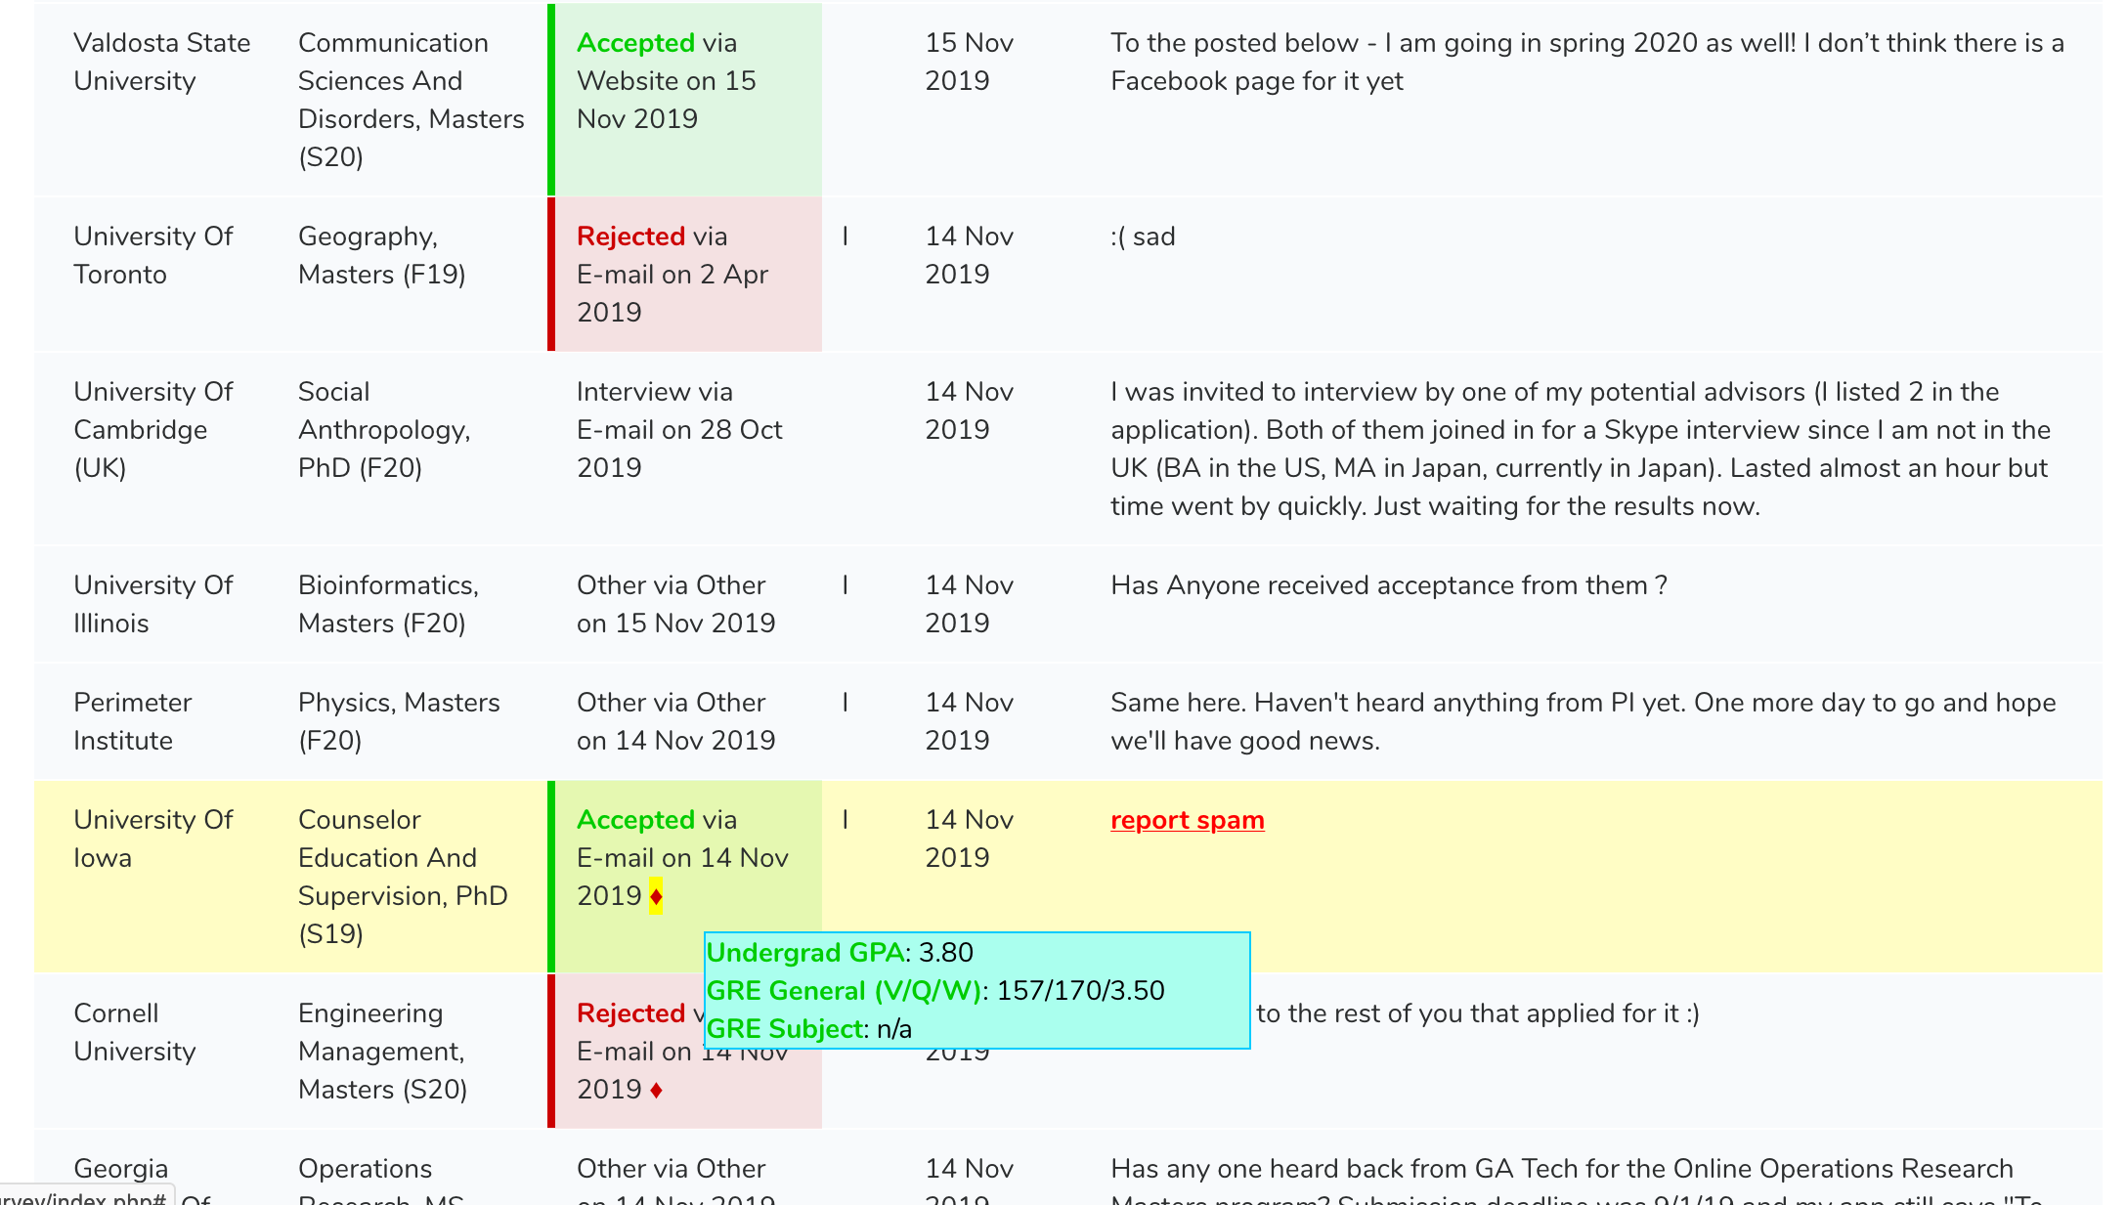
Degree
Subject
Application year
School name
Decision
Decision date
Notes

Slide 16
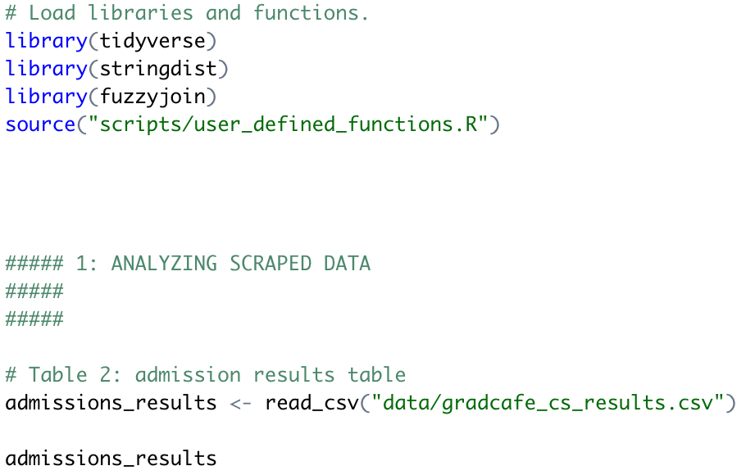
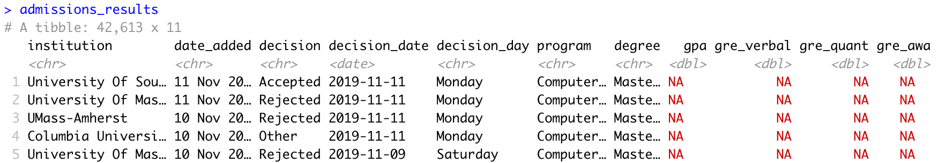

Slide 17
Exercise: use tidyverse-compliant functions to investigate the admissions results data. (Jump to script)
Compute the mean GPA (0 < gpa <= 4) for PhD applicants only
Compute the mean total GRE scores (130 <= gre_* <= 170) for PhD applicants only
Print the 50 schools with the most results overall in descending order

Slide 18
COMBINING DATA SETS
Intro
Joins
Fuzzy string matching
Fuzzy joins
Conclusion

Slide 19


Slide 20
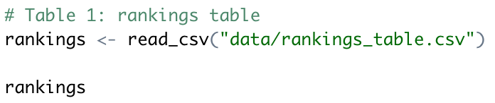
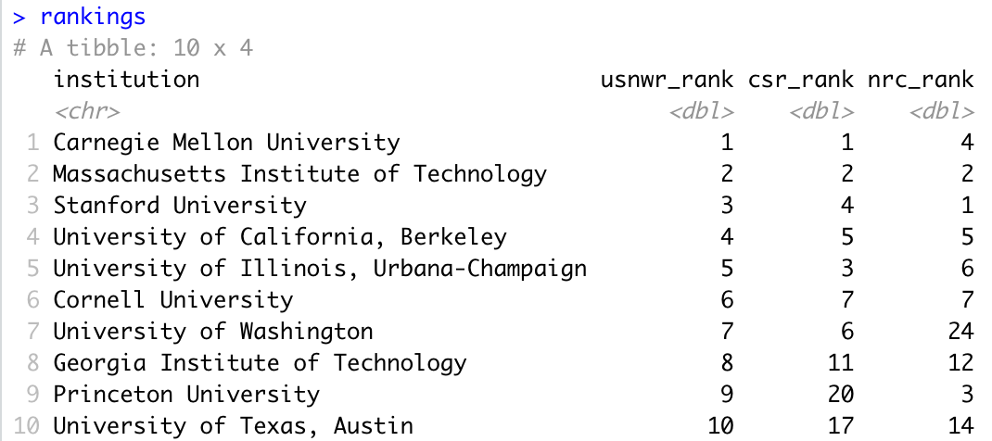

Slide 21

Goal: we want to combine the rankings from the first table with the admissions results from the second table where the institution name matches into a single table – otherwise known as a join or inner join.
x: name of first table
y: name of first table
by: the name(s) of the key(s), or column with values to be matched between x and y
suffix: suffix to distinguish non-key columns with names in both x and y

Slide 22
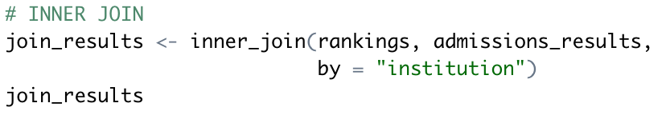
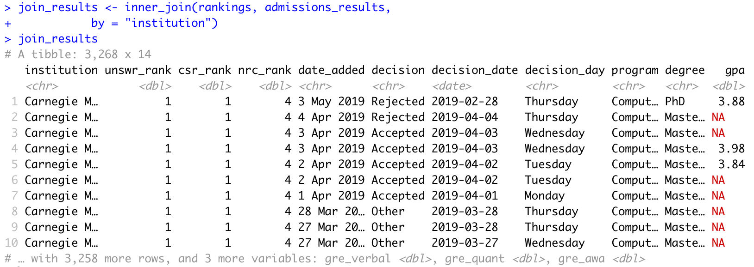

Slide 23
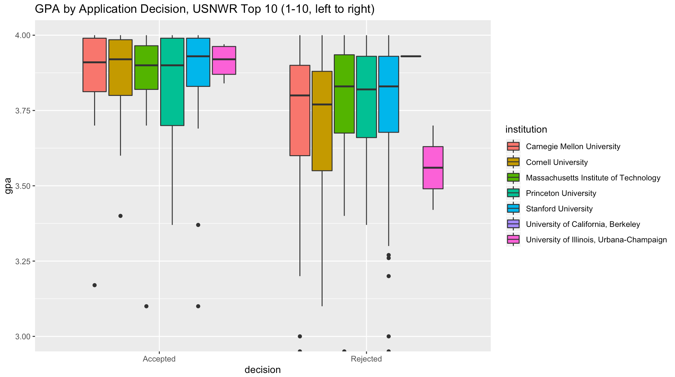
Visualizing the join, we see only 7 institutions matched. What gives?

Slide 24
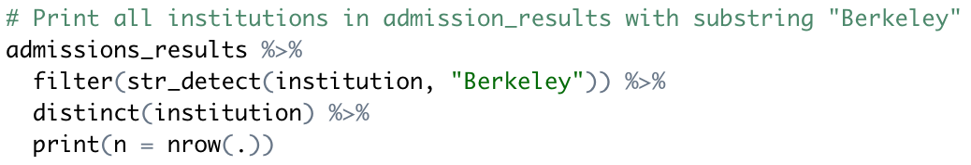
Let’s take a look at entries containing “Berkeley” in admissions_results:

Slide 25
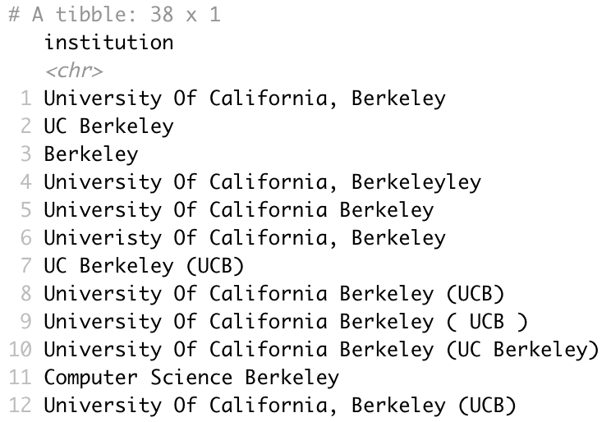
There are 38 different schools containing “Berkeley”! (And these are just the ones that spelled “Berkeley” right somewhere.) Here are the first 12:

Slide 26
Standardization: we can fix many of the problems by…
conversion to lower case
stripping punctuation
cleanup of leading/trailing/multiple whitespaces
removing relatively uninformative words (e.g. “university”, “institute”, “school”, “at”, and “of”)
why? common/structural words artificially reduce distance of non-matches and offer little extra info re: true matches
A user-defined function loaded by source() does all of this for us.

Slide 27
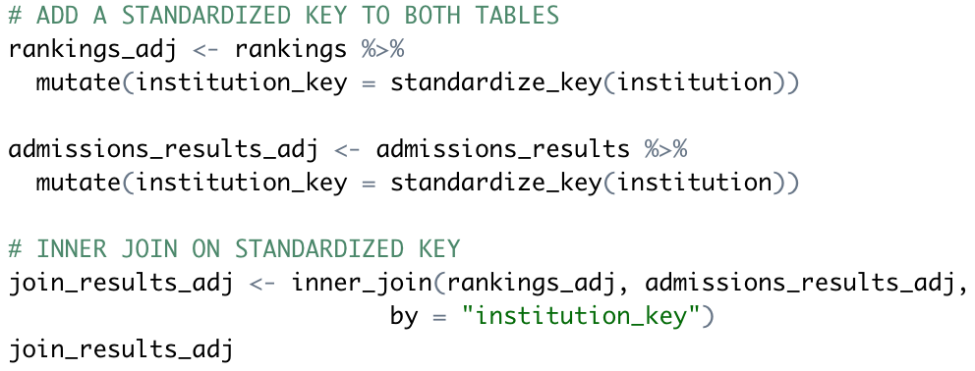
Adding standardized keys and redoing the join (jump to script):
How many more matches do we see?

Slide 28
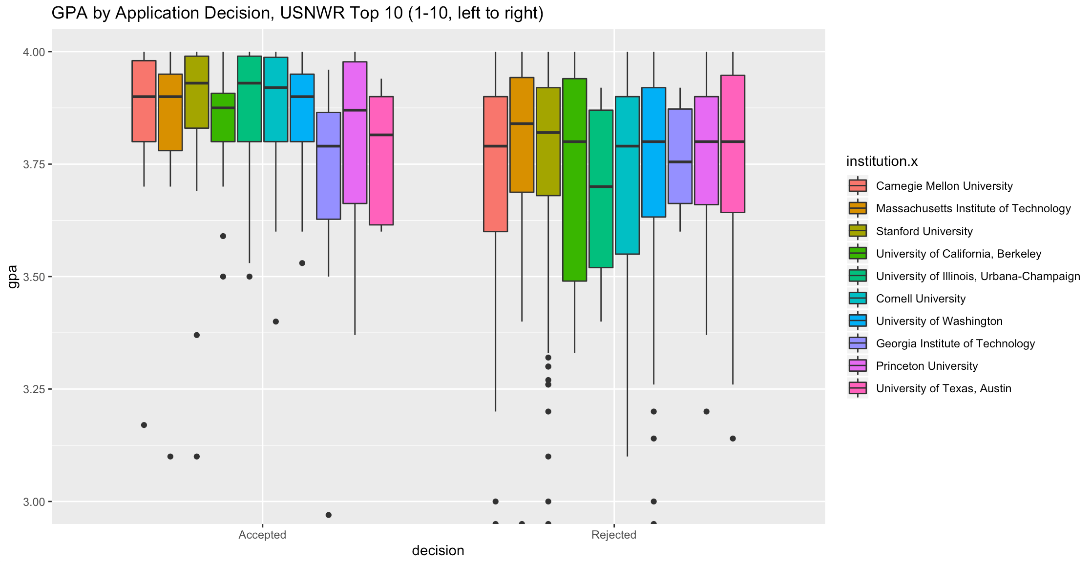
This looks better – at least all 10 institutions match some results.

Slide 29
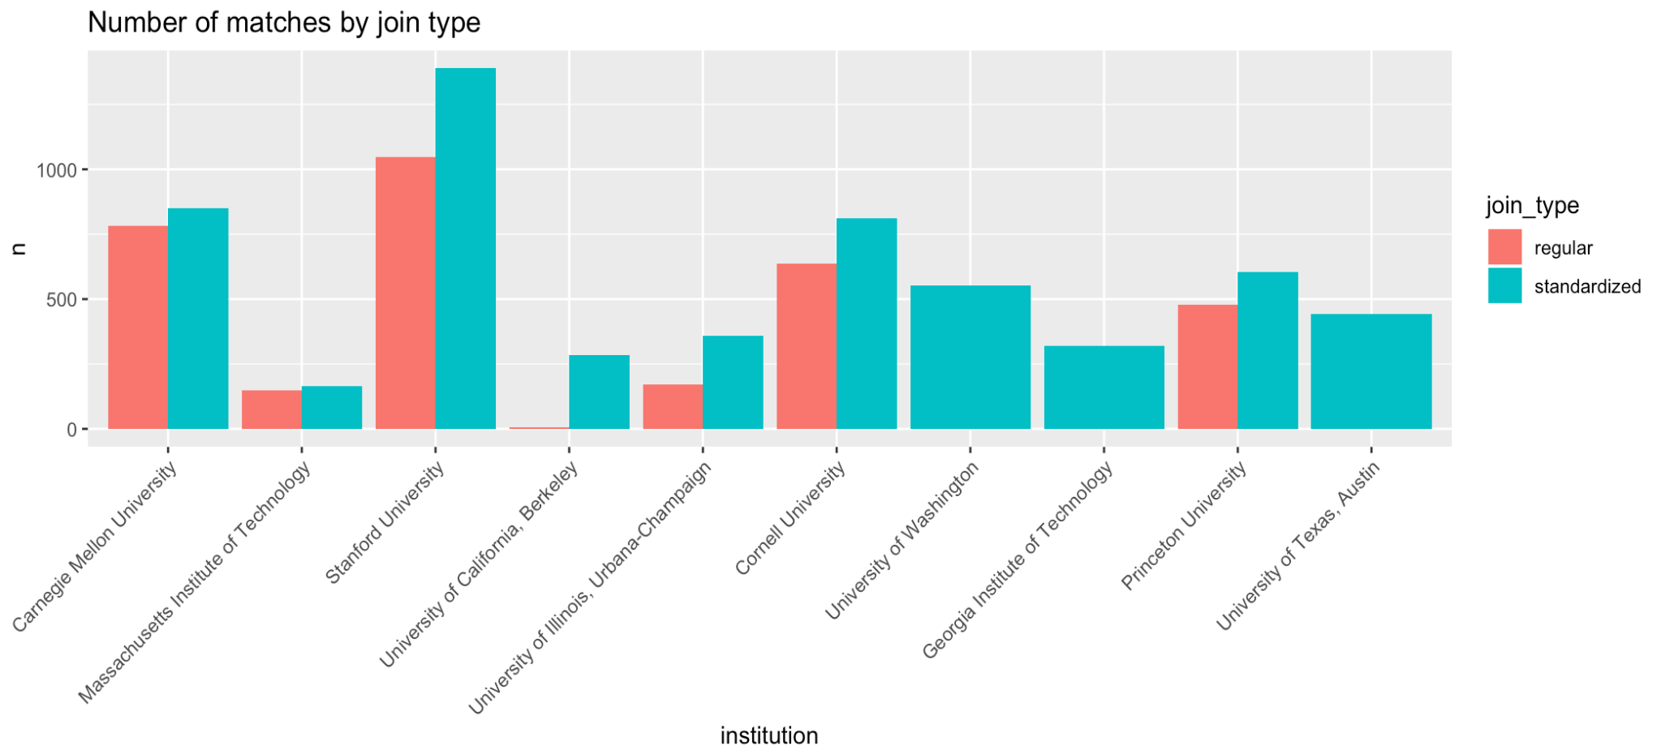
Idiosyncratic number of matches suggests more room for improvement.

Slide 30
MEASURING CLOSENESS OF STRINGS
Intro
Joins
Fuzzy string matching
Fuzzy joins
Conclusion

Slide 31

The difference between two strings can be measured by a string distance function. These functions come in many different flavors and are useful in different contexts – we’ll discuss four of them.
string a = first string
string b = second string
method = distance function name
… = auxiliary arguments

Slide 32
Levenshtein distance: given two strings, how many character insertions, deletions, and substitutions would it take to transform the first string to a second string?
“Northwestern”

Slide 33
Levenshtein distance: given two strings, how many character insertions, deletions, and substitutions would it take to transform the first string to a second string?
“Northwestern” → “Northeestern”

Slide 34

Levenshtein distance: given two strings, how many character insertions, deletions, and substitutions would it take to transform the first string to a second string?
“Northwestern” → “Northeestern” → “Northeastern”
distance = 2
Check for yourself:

Slide 35
Levenshtein distance ratio: given two strings, compute the Levenshtein distance. Then, divide by the length of the longer of the two strings.
“Northwestern” → “Northeestern” → “Northeastern”

Slide 36

Levenshtein distance ratio: given two strings, compute the Levenshtein distance. Then, divide by the length of the longer of the two strings.
“Northwestern” → “Northeestern” → “Northeastern”
both strings are 12 characters long
so, distance ratio is 2/12 = .167

Slide 37
q-gram distance: given two strings, divide them into grams of size q, throwing out duplicates. How many grams are not shared by the strings?
(q = 2)
2-grams
Northwestern
No

Slide 38
q-gram distance: given two strings, divide them into grams of size q, throwing out duplicates. How many grams are not shared by the strings?
(q = 2)
2-grams
Northwestern
or
No
Northwestern

Slide 39
q-gram distance: given two strings, divide them into grams of size q, throwing out duplicates. How many grams are not shared by the strings?
(q = 2)
2-grams
Northwestern
Northwestern
or
th
No
rt
Northwestern
Northwestern
hw
es
Northwestern
Northwestern
st
we
Northwestern
Northwestern
te
rn
er
Northwestern
Northwestern
Northwestern

Slide 40

q-gram distance: given two strings, divide them into grams of size q, throwing out duplicates. How many grams are not shared by the strings?
Northwestern
Northeastern
or
th
or
th
No
rt
No
rt
hw
es
he
as
st
we
st
ea
te
rn
te
rn
er
er
distance = 6

Slide 41
Jaccard distance: given two strings, compute the q-gram distance, and divide by the number of unique grams between the two strings.
es
hw
ea
we
he
as

Slide 42
Jaccard distance: given two strings, compute the q-gram distance, and divide by the number of unique grams between the two strings.
es
hw
ea
we
he
as
as
or
th
No
rt
he
hw
es
st
we
ea
te
rn
er

Slide 43

Jaccard distance: given two strings, compute the q-gram distance, and divide by the number of unique grams between the two strings.
es
hw
ea
we
he
as
6
=
=
.429
as
14
or
th
No
rt
he
hw
es
st
we
ea
te
rn
er

Slide 44
Notes:
The value of q should generally get larger as the keys get longer; q = 2 or 3 suffices for most strings of sentence length or shorter.
Increasing q generally means
distances overall will increase – bigger library of grams, more mismatches
you care more about the structure of the word than letters
If one string pair has a lower distance at q = 2 than another, that does not guarantee that pair will have a lower distance at q = 3

Slide 45
Exercise: find the closest match (smallest distance) among the pairs of strings below by (a) Levenshtein distance ratio; (b) Jaccard distance, q = 2.
“Dartmouth College” and “Darmtouth College”
“University of California” and “The University of California”
“Stanford University” and “University of Stanford”
How do the distances vary between the two metrics?
Given that these strings are all matches, do you prefer one metric?

Slide 46
COMBINING DATA SETS, FUZZILY
Intro
Joins
Fuzzy string matching
Fuzzy joins
Conclusion

Slide 47
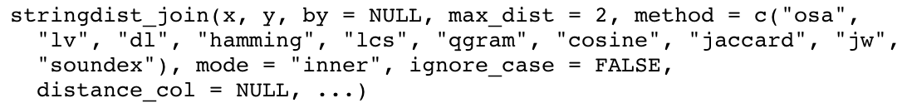
x: name of first table
y: name of first table
by: the name(s) of the key(s), or column with values to be fuzzily matched between x and y
max_dist: returns only matches with distance smaller than this threshold
method: specifies the string distance function to use
distance_col: the name of a column to be added with the key distance for each row

Slide 48
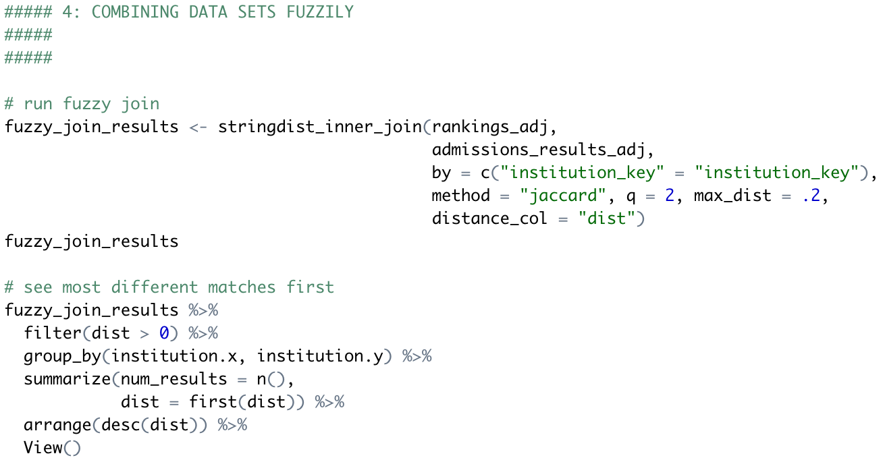
(Jump to R script)

Slide 49
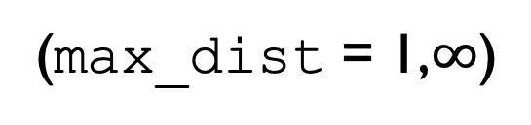
Selecting a max_dist: assessing your appetite for potential mismatches.
(max_dist = 0)
(max_dist = 1,$∞$)

Slide 50

Selecting a max_dist: assessing your appetite for potential mismatches.
Tyranny
(max_dist = 0)
(max_dist = 1,$∞$)
Only perfect matches
No mismatches (0 false positives, perfect precision)

Slide 51

Selecting a max_dist: assessing your appetite for potential mismatches.
Tyranny
ANARCHY
(max_dist = 0)
(max_dist = 1,$∞$)
Only perfect matches
No mismatches (0 false positives, perfect precision)
EVERYTHING matches!
Lots of false positives, perfect recall

Slide 52

Selecting a max_dist: assessing your appetite for potential mismatches.
Tyranny
ANARCHY
(max_dist = 0)
(max_dist = 1,$∞$)
Only perfect matches
No mismatches (0 false positives, perfect precision)
Happy medium!
Lots of correct matches, few mismatches
Varies by user and use case
EVERYTHING matches!
Lots of false positives, perfect recall

Slide 53
A general strategy for finding your happy medium:
Start with near-tyranny (low max_dist, e.g. .05)
Pick a stopping rule
Increase max_dist a bit, and look at the matches with the highest distance between them. Do they break your stopping rule?
Sample stopping rules:
I won’t accept any mismatches at all (no risk, lowest reward)
I’ll accept at most X mismatches total (low risk, moderate reward)
increasing max_dist must result in Y times as many true matches than mismatches (medium risk, highest reward)

Slide 54
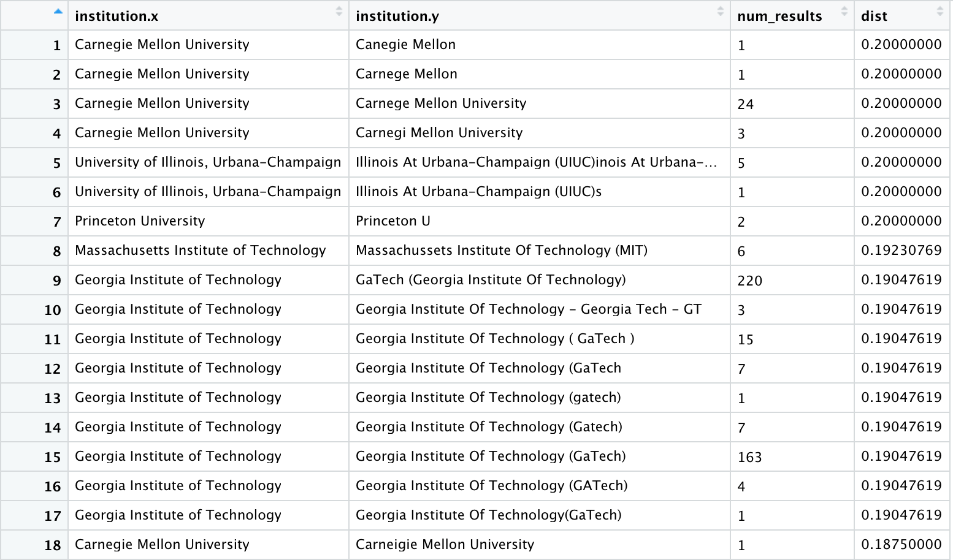

Slide 55
Exercise: find the threshold you are most comfortable with in our fuzzy join problem. You can choose to use one of the example stopping rules, or just come up with your own by feel.
Rerun the join with a higher max_dist parameter;
Check the matches with the highest distance using the data viewer.
If you’re still comfortable, repeat steps 1 and 2.
If you like: use whichever string distance you prefer. There’s no built-in method for a join on Levenshtein ratio; I’ve written a wrapper that will do the join for you (lvr_inner_join), already loaded into your R session.

Slide 56
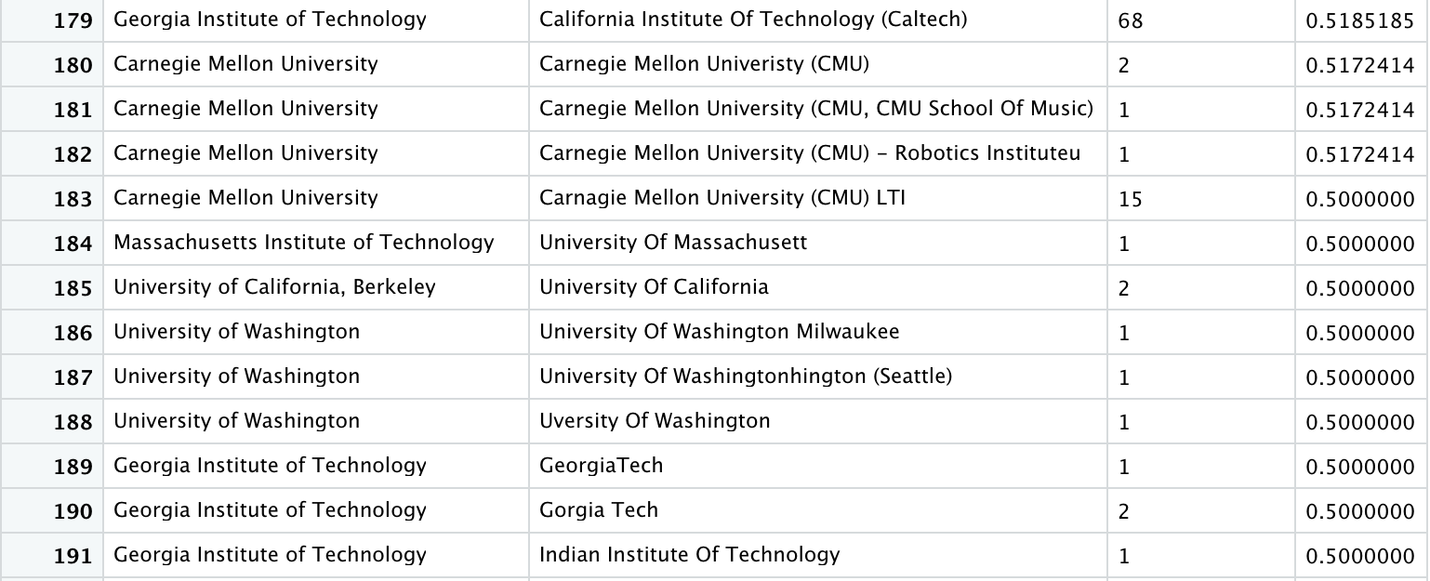

Setting the threshold at .518:

Slide 57
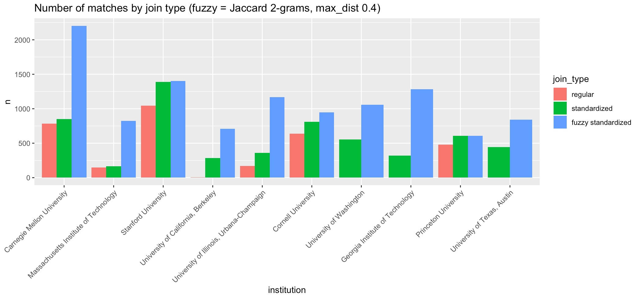
Now we have much more data at minimal cost, and improved parity:

Slide 58
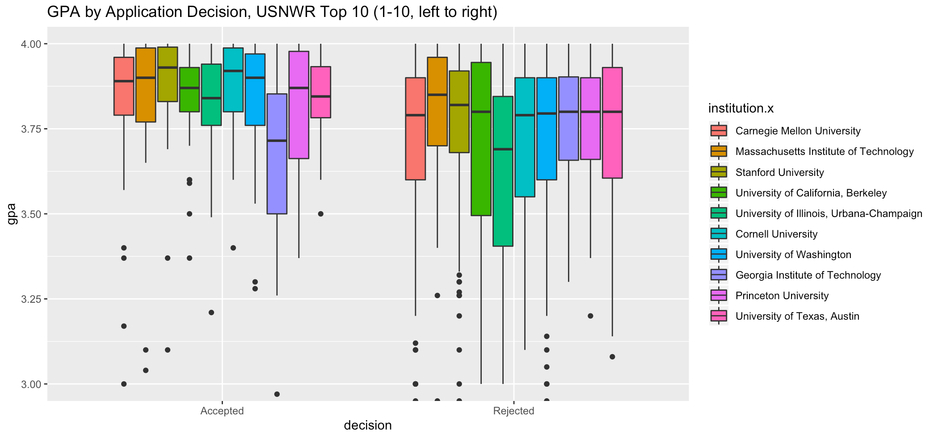
The colorful fruits of our labor!

Slide 59
RECAP
Intro
Joins
Fuzzy string matching
Fuzzy joins
Conclusion

Slide 60
RECAP
Today, we…
discussed techniques for increasing the number of matches in a join via string distances
compared a few choices of string distance for this purpose
tuned parameters to maximize the true match rate while minimizing the false match rate (maximize recall at minimal cost to precision)
worked through a real example on scraped data

Slide 61
THANKS FOR YOUR TIME! QUESTIONS?

Slide 62
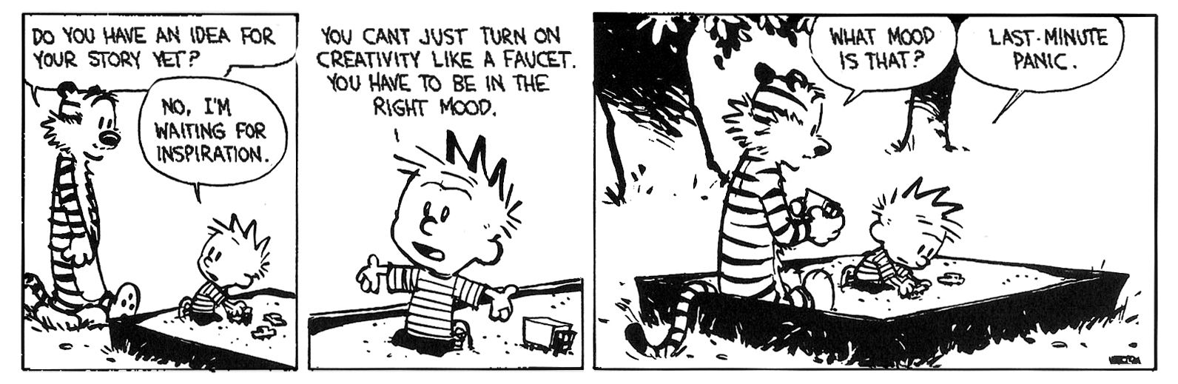
Today, we’ll step into the shoes of an R-savvy grad school hopeful and expert productive procrastinator.

